Slide 1
Capacity Development Program in Environment Management (CDEM)
Module 1: Environment Policy and Regulations
Environmental Impact Assessment Notification
26th September to 30th September 2016
K.J.Somaiya College, Mumbai

Slide 2
?
What is an ‘Impact'
Notes:
example of a car as activity, aspect of emissions, impact as deterioration of air quality
Posed as a question to the students.

Slide 3
Is the Impact
due to
emissions from a moving car
equivalent to
cutting of trees for making a road through Sanjay Gandhi National Park
?
Significance of Impacts
Notes:
Nature – reversible, irreversible
Duration – long term, short term
Extent – local, regional
Order – direct, indirect

Slide 4
Impact Classification
Nature – reversible, irreversible
Duration – long term, short term
Extent – local, regional
Order – direct, indirect

Slide 5
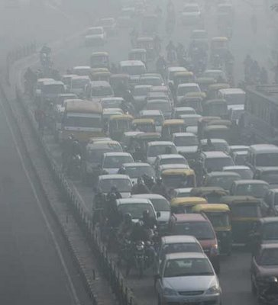
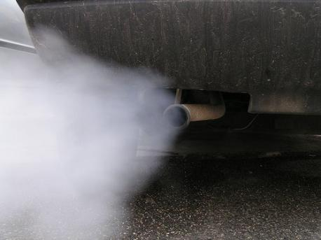
Traffic Congestion - Air Pollution

Slide 6
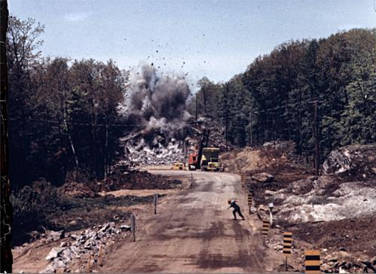
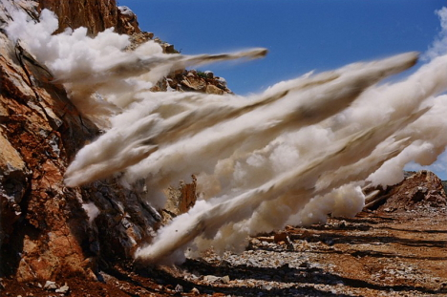
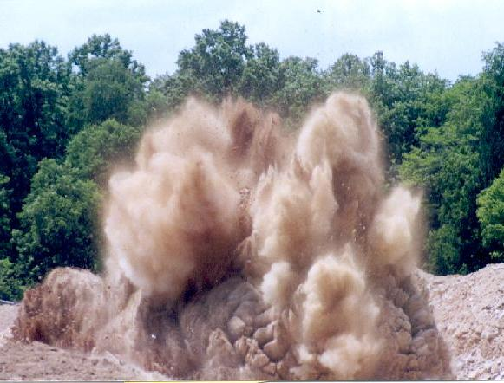
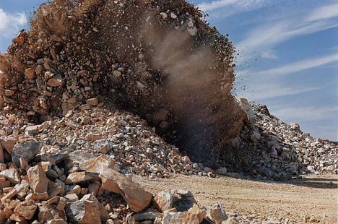
Blasting – Noise Pollution

Slide 7
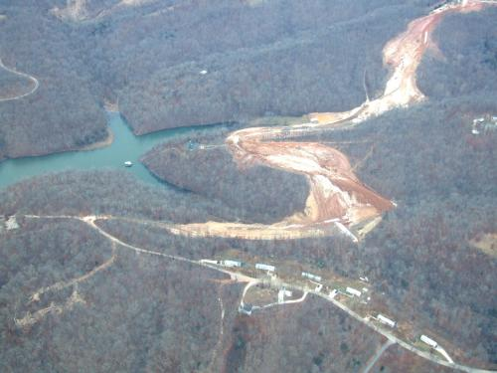
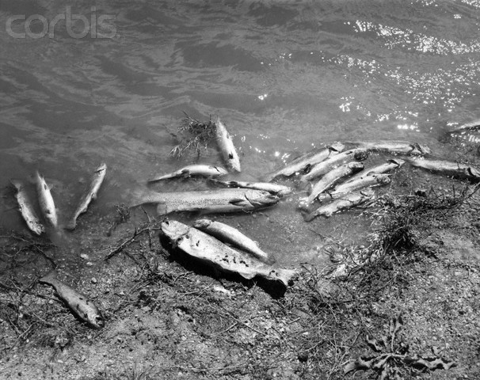
Runoff from construction - Water Pollution

Slide 8
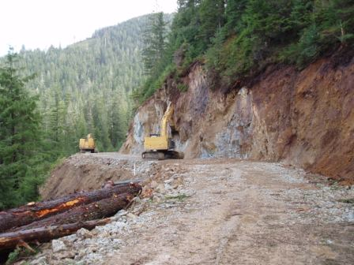
Highway Construction through forest areas on hilly terrain – Loss of habitat

Slide 9
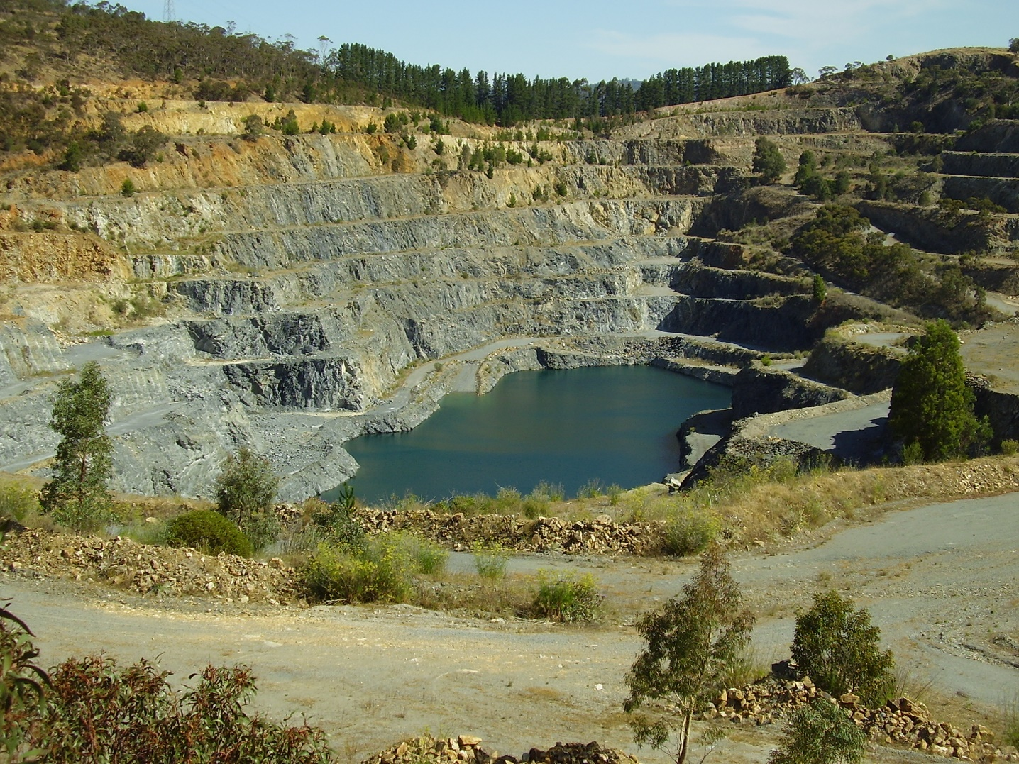
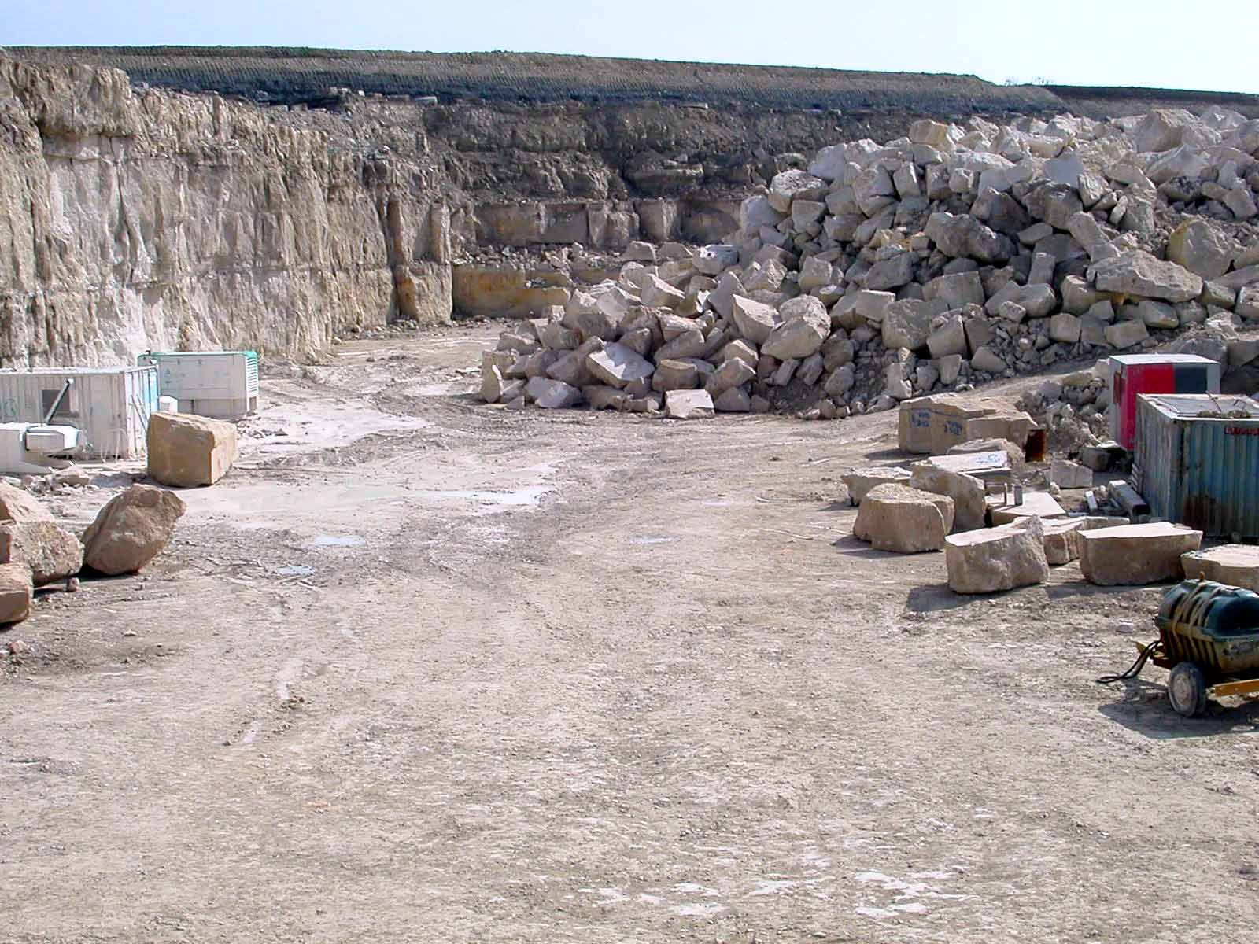
Quarry for Construction Material – Land degradation

Slide 10
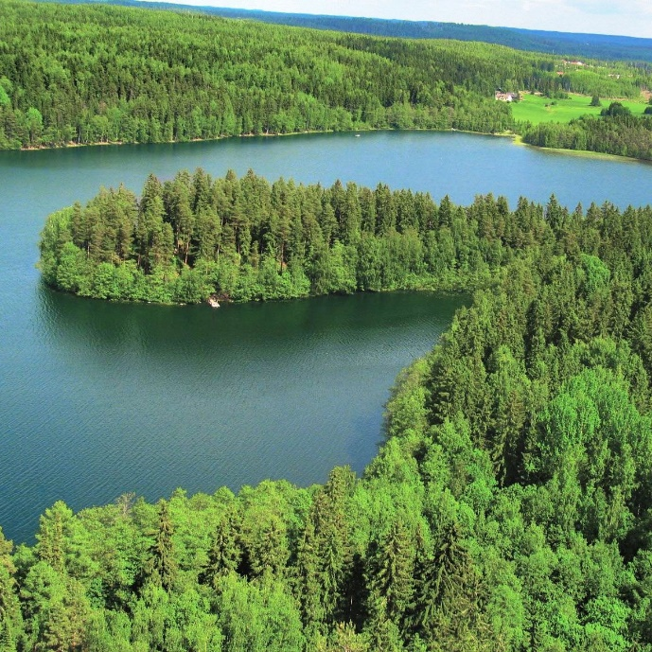
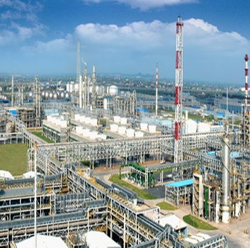
PROTECTION
INPUT – Resource extraction, Land, Water, Trees etc.
NATURAL RESOURCES
ENVIRONMENTAL IMPACTS
DEVELOPMENT ACTIVITIES
PROCESS OUTPUTS – Effluents, emissions, waste
MANAGEMENT

Slide 11
What is EIA?
A proactive tool
that anticipates environmental and social implications of the developmental project, programmes, plans and policies …
A process
that influences the concept, design, implementation, operation of the project development cycle to add a value and lend sustainability …
An integrated, participatory, consultative and transparent mechanism to development

Slide 12
What is Environmental Clearance?
Environmental Clearance is a permit issued by the regulatory authority for allowing development of certain types of projects/ activities

Slide 13
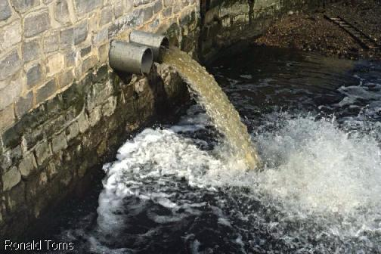
Why do Projects require Environmental Clearance?
Development of projects leads to adverse impacts on the environment.
If these impacts are not identified and prevented/ mitigated, they could lead to permanent environmental damage and diminish the effectiveness of the project.
An Environmental Clearance ensures that adverse impacts are identified and prevention/ mitigation measures are designed.

Slide 14
At what stage of a project does environmental clearance have to be obtained?
Project Cycle
Planning & Design
Operation
Construction

Slide 15
Who is required to obtain the Environmental Clearance from the Regulatory Authority?
The Environmental Clearance has to be obtained by the Project Developer/ Proponent

Slide 16
How is Environmental Clearance obtained for a project?
An Environmental Impact Assessment of the project and its allied facilities is carried out.
The outcome of the study is submitted to the Regulatory Authority for a Clearance.

Slide 17
Environmental Clearance in India
The Environmental Clearance Process in India is governed by the Environmental Impact Assessment Notification.
The first Notification was introduced in 1994.
The current active Notification is of 2006.

Slide 18
Which Projects Require Environmental Clearance?
All new projects or activities listed in the Schedule of the EIA Notification, 2006
Expansion and modernization of existing projects or activities listed in the Schedule of the notification
with addition of capacity crossing the threshold limits given in the Schedule, after expansion or modernization
Any change in product - mix in an existing manufacturing unit included in Schedule beyond the specified range

Slide 19
Key Milestones in Environmental Clearance in India
SCREENING
SCOPING
PUBLIC CONSULTATION
APPRAISAL

Slide 20
Categorization
Categorization
New Project
Expansion Project
Screening
Check if project requires prior Environment Clearance as per Schedule in EIA Notification
Scoping
If project requires prior Environment Clearance
Preparation of Draft EIA & EMP Report
Category A
Category B
Public Consultation
If SEIAA / SEAC not constituted
Appraisal
If Project fulfills General Conditions
Post Environmental Clearance Monitoring
Apply for prior Environment Clearance

Slide 21
General Conditions
A project or activity specified in Category ‘B’ will be treated as Category ‘A’
If located in whole or in part within 10 km from the boundary of
Protected Areas notified under the Wild Life (Protection) Act, 1972
Critically Polluted areas as notified by the Central Pollution Control Board from time to time
Notified Eco-sensitive areas
Inter-State boundaries and international boundaries

Slide 22
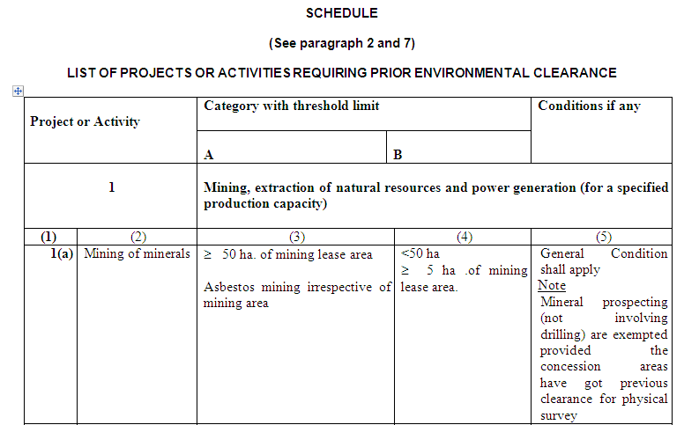
Categorization Reference
Refer to Schedule in EIA Notification 2006

Slide 23
Institutional Mechanism
Projects / activities under Category ‘A’ in the Schedule are to be referred to the Ministry of Environment and Forests at the Central Level
Projects/ activities under Category ‘B’ in the Schedule are to be referred to the State Environmental Impact Assessment Authority (SEIAA) at the State level
Expert Appraisal Committees constituted at the Central and State levels are a panel of sector experts who review the project / activity and give recommendations for EC

Slide 24
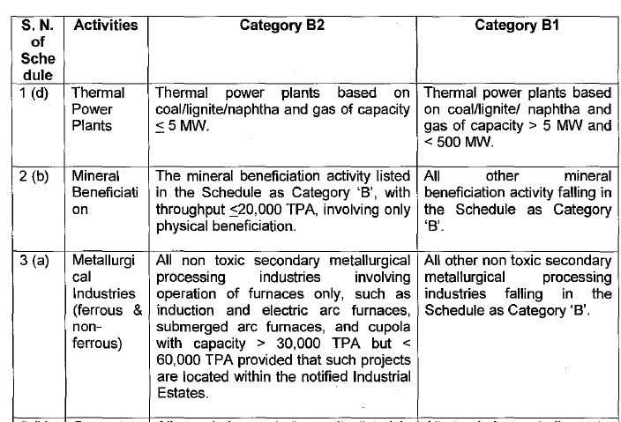

Slide 25
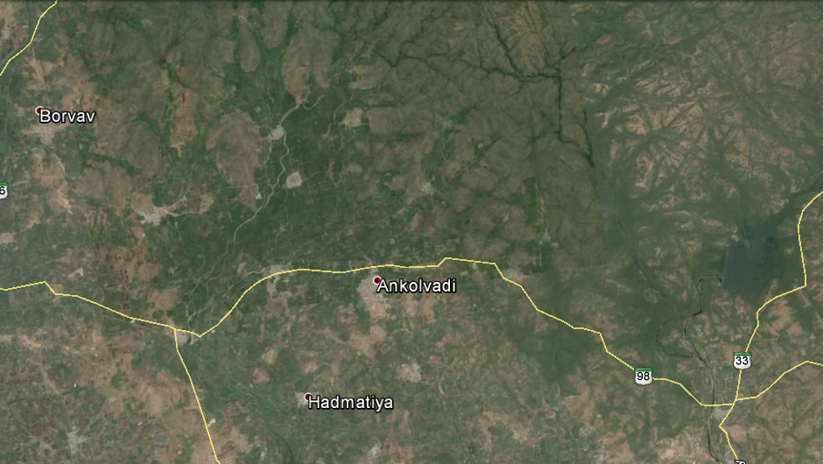
Sample Project Categorization
Widening of SH-98 bordering Gir National Park in Gujarat length 40 km with land acquisition of 20 m width. The road highest elevation is 500 MSL
GIR National Park

Slide 26
EIA Schedule

Slide 27
General Conditions
Any project or activity specified in Category ‘B’ will be treated as Category A, if located in whole or in part within 10 km from the boundary of:
(i) Protected Areas notified under the Wild Life (Protection) Act, 1972,
(ii) 29[Critically Polluted areas as notified by the Central Pollution Control Board] from time to time,
(iii) Notified Eco-sensitive areas as notified under Section 3of the Environment (Protection) Act, 1986, such as Mahableshwar, Panchgani, Matheran, Pachmarhi, Dahanu, Doon Valley, and
(iv) inter-State boundaries and international boundaries.

Slide 28
Screening
Only for Category B projects
Categorization
Screening
Application to SEIAA for EC with Form –I and Pre-feasibility report
Scoping
Scrutiny of application by SEAC
Preparation of Draft EIA & EMP Report
(Based on nature and location)
Public Consultation
Requires EIA – Category B1
Does not require EIA – Category B2
Appraisal
Post Environmental Clearance Monitoring
Stage 2 - Scoping
Stage 4 - Appraisal

Slide 29
Scoping
For Category A & B1
Based on:
Application i.e. Form-I
TOR proposed by applicant
Site visit by sub group of EAC/SEAC (optional)
Determine Terms of Reference (TOR)
Categorization
Screening
Is application
Accepted?
Scoping
No
Rejection conveyed to applicant with reasons in 60 days
Preparation of Draft EIA & EMP Report
Yes
If TOR is not conveyed to applicant within 60 days of receipt of application, TOR proposed by applicant to be considered final.
Public Consultation
Final TOR conveyed to applicant in 60 days
Appraisal
All projects and activities listed as Category ‘B’ in Item 8 of the Schedule shall not require Scoping and will be appraised on the basis of Form 1/ Form 1A and the conceptual plan
Prepare draft EIA report
Post Environmental Clearance Monitoring
Stage 3 – Public Consultation

Slide 30
Conduct of Environmental Impact Assessment Studies and Preparation of Draft Report including Environmental Management Plan

Slide 31
Public Consultation
Categorization
Screening
Scoping
Two modes of public consultation
Public Hearing
Obtain responses in writing
Preparation of Draft EIA & EMP Report
Public Consultation
Appraisal
Post Environmental Clearance Monitoring

Slide 32
Request by applicant to Member Secretary SPCB
Submission of 1 hard & 1 soft copy of draft EIA report and summary of EIA report to
MoEF,
District Magistrate,
Zilla Parishad or Municipal Corporation,
District Industries Centre &
Regional office of MoEF.
Categorization
Letter of request accompanied by
10 hard and 10 soft copies of draft EIA report
Summary of EIA in English & local language
Screening
Scoping
Preparation of Draft EIA & EMP Report
Publicize at local level
Publicize at local and state level
The following will publicize within their jurisdictions -
District Magistrate,
Zilla Parishad or Municipal Corporation,
District Industries Centre &
Regional office of MoEF
Display summary of draft EIA report on MoEF website. Full draft EIA available at Ministry at Delhi. Invitation for comments till Public Hearing is over.
SPCB – within state & summary available in Public libraries / Panchayats / Selected offices for inspection
Public Consultation
Appraisal
Notice of Public Hearing
Public Hearing
Post Environmental Clearance Monitoring
Notice period min. 30 days
Advertise venue & offices where information on project available in National and Regional vernacular daily
Public Hearing supervised & presided by District Magistrate or his/her representative.
Video film made of entire proceedings
Attendance of all present is noted

Slide 33
Public Hearing
Applicant’s representative gives presentation on project & EIA
Categorization
Clarifications & information taken from Applicant
Screening
Summary of Public Hearing reflecting views & concerns to be recorded by representative of SPCB / UTPCC
Scoping
Preparation of Draft EIA & EMP Report
Summary of Public Hearing to be read at the end of proceeding
Proceedings shall be displayed at
- Panchayat office
- Zilla Parishad
- District Magistrate’s office
- SPCB/UTPCC office and website
Comments may be sent directly to regulatory authority or applicant
Public Consultation
Proceeding signed by District Magistrate or Representative
Appraisal
Proceeding forwarded to SPCB / UTPCC
Post Environmental Clearance Monitoring
Public Hearing proceedings sent to Regulatory Authority within 8 days of its completion

Slide 34
APPRAISAL
Item 8 of schedule - Form I + Form IA + Conceptual plan
Form I + Form IA + Conceptual plan
Application with following documents
20 hard & 1 soft copy of final EIA report
Video/CD of Public Hearing proceedings
Final Layout Plan 20 copies
Project feasibility report 1 copy
Public consultation not mandatory – Form I & Pre-feasibility report
Public hearing proceedings & public responses
Scrutiny by regulatory authority in 30 days
Application & all documents sent to EAC/SEAC for Appraisal
Invitation to applicant for proceedings for appraisal (notice of 15 days given)
EAC/SEAC recommendations to regulatory authority in 60 days
If recommendations rejected by regulatory authority
Regulatory authority request EAC to reconsider recommendations in 45 days of receipt of documents
If recommendations accepted by regulatory authority
EAC furnishes its views to regulatory authority in 60 days
Regulatory authority considers recommendations & conveys its decision to applicant in 45 days
Decision conveyed by regulatory authority to applicant in 30 days

Slide 35
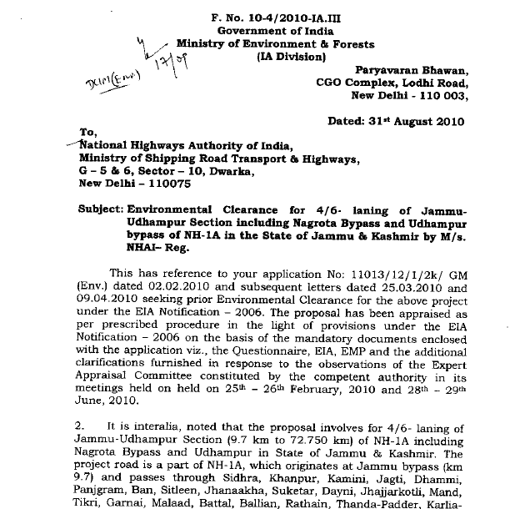
Environmental Clearance

Slide 36
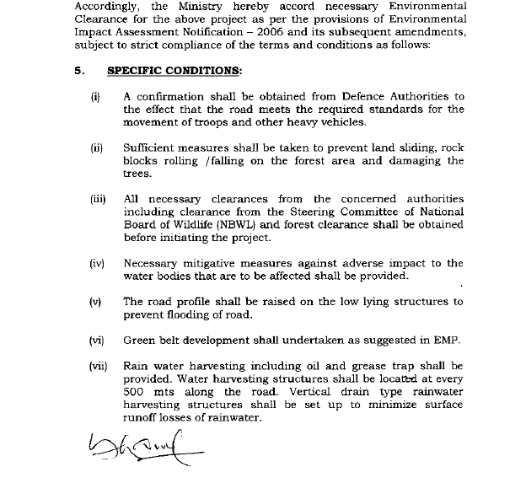

Slide 37
Post Environmental Clearance monitoring
EC terms & conditions stipulated in the Appraisal
Half yearly compliance reports for above
Compliance reports made public documents
Copies of these documents given to any person on application
Latest report displayed on website of regulatory authority

Slide 38
Monitoring EC Conditions
Types of conditions:
Limits on use of natural resource
Pollution prevention and management
Obtaining permits from other regulatory agencies
Creation of infrastructure
Defining manpower requirements
Monitoring and reporting
CAPEX for the measures to be identified

Slide 39
Permit
Infra creation

Slide 40
Natural Resource
Pollution Management

Slide 41
Validity of Environmental Clearance
The period from which a prior EC is granted by the regulatory authority, to the start of production operations by the project or activity, or completion of all construction operations in case of construction projects (item 8 of the Schedule).
10 years in the case of River Valley
30 years for mining projects
7 years in the case of all other projects and activities
Validity may be extended by a maximum period of 7 years on application.

Slide 42
STAGE - 1
Application for prior EC
TIME REQUIREMENT FOR Obtaining EC
60 days
TOR conveyed to Applicant
STAGE - 2
STAGE - 3
Public Consultation
Require Public Hearing
Do not require Public Hearing
Request for Public Hearing by applicant to SPCB
7 days
Draft EIA report & application put on website for responses from concerned persons
45 days
If Public Hearing not conducted& proceedings forwarded to regulatory authority, it appoints another agency
45 days
SPCB forwards Public Hearing proceedings to regulatory authority
45 days
Agency forwards proceedings to regulatory authority
Final EIA report with other specified documents

Slide 43
30 days
Scrutiny by regulatory authority
STAGE - 4
60 days
Appraisal complete
15 days
Recommendations by EAC to regulatory authority
If authority disagrees with EAC recommendations
45 days
45 days
Decision to applicant by regulatory authority
Request for reconsideration by regulatory authority to EAC
60 days
EAC considers observations made by regulatory authority & gives views
30 days
Decision by regulatory authority to applicant

Slide 44
Timeline for Environmental Clearance
For Category A Projects & Category B1 Projects requiring Public Hearing:
Minimum Time – 255 days
Timeline with delays – 390 days
For Category B1 projects without Public Hearing:
Minimum Time – 210 days
Timeline with delays – 300 days
For Category B2 projects
Maximum Timeline - 180 days
Does not include time required for Preparation of EIA Report

Slide 45
NABET Accreditation
National Accreditation Board for Education and Training (NABET) conducted first set of accreditation of environmental consultants in 2010-11
Environmental Consultants with accreditation under NABET are only allowed to conduct EIA and present it to the EAC/ SEAC since June 2011
Accreditation has been given based on
Sectors
Categories of projects

Slide 46
Common Misconceptions about Environmental Clearance
A project which is granted EC, does not require Forest and/or Wildlife Clearance.
If a project does not require EC, it does not require Coastal Regulation Zone Clearance.
EC is same as Consent to Establish and Consent to Operate.
Grant of building permission from Municipal Corporation encompasses EC.
FALSE
FALSE
FALSE
FALSE

Slide 47
Module Coordinator:
Dr.Prasad Modak, Ekonnect Knowledge Foundation
Address:
504/505, 5th Floor, Balarama Building,
Bandra Kurla Complex, Near MMRDA Office
Bandra (East) Mumbai – 400 051
Tel : 91 022 6221 5944/5946
Website:
www.ekonnect.net
Facebook:
https://www.facebook.com/EkonnectKnowledgeFoundation/?ref=hl
Ekonnect Knowledge Foundation is a not for profit company offering education and awareness on Environment, CSR & Sustainability.
CDEM is a program conceived and organized by K.J.Somaiya in partnership with and support of MMR-EIS. This module 1 is part of the 5 module diploma certificate offered under this program.

Slide 48
Discussion – Role Play Exercise
Scenario – Draft Notification on Environmental Supplemental Plan
Roles:
Group 1 - Ministry of Environment & Forests
Group 2 - Project Proponent/ Industry
Group 3 - Environmental Experts
Task - In your respective Roles discuss the pros and cons of the draft notification

